Slide 1

What is a neural net? Aziz Kustiyo
Metode Kuantitatif
Departemen Ilmu Komputer FMIPA IPB

Slide 2

Berat OTAK manusia
- lahir 350 gr
- 3 bulan 500 gr
- 18 bulan 1000 gr
- 6 tahun 1300 gr

Slide 3
BENTUK OTAK YANG UNIK
OTAK TERDIRI DARI 100-200 MILYARD SEL AKTIF YANG SALING BERHUBUNGAN
OTAK BESAR TERDIRI DARI 2 BELAHAN, YAITU BELAHAN KIRI & KANAN
MASING2 BELAHAN DIHUBUNGKAN OLEH JEMBATAN YANG DISEBUT CORPUS CALOSUM

Slide 4
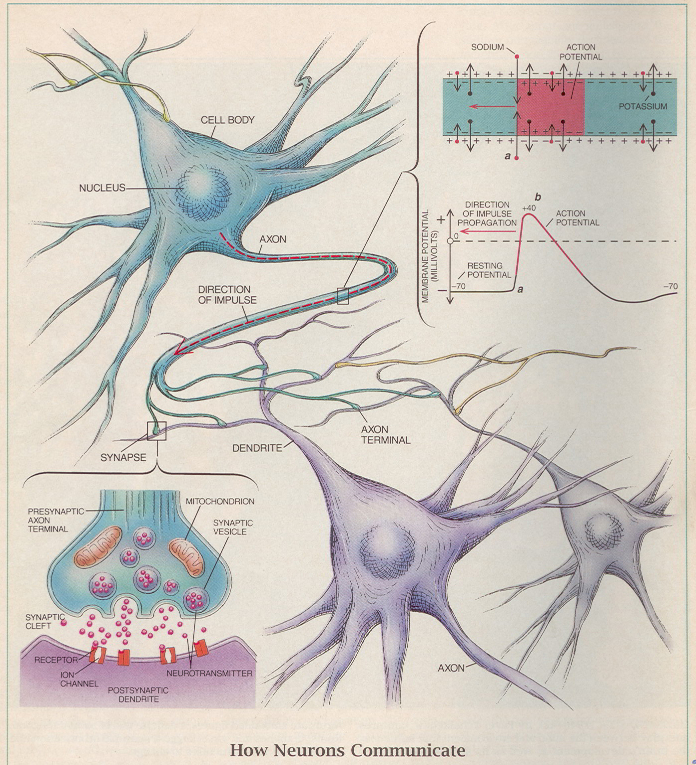

Slide 5
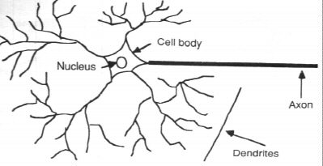
BIOLOGICAL NEURON…

Slide 6
1. Biological neurons
Several key features of the processing elements of ANN are suggested by the properties of biological neurons, that:
The processing elements receives many signals
Signals may be modified by a weight at the receiving synapse
The processing elements sum the weighted inputs

Slide 7
1. Biological neurons…
Under appropriate circumstances, the neuron transmits a single output
The output from a particular neuron may go to many other neurons (the axon branches)
Information processing is local

Slide 8
1. Biological neurons…
Memory is distributed:
Long term memory resides in the neuron’synapse or weight
Short term memory corresponds to the signal sent by neuron
A synapse’s strength may be modified by experience
Neurotransmitter for synapses may be inhibitory or excitatory

Slide 9
2. Artificial Neural Networks (ANN)
An ANN is
An information-processing system that has certain performance characteristics in common with biological neural networks
generalizations of mathematical models of human cognition or neural biology based on several assumptions.

Slide 10
2. ANN …
The assumptions are
Information processing occurs at many simple elemen called neurons
Signals are passed between neurons over connection links
Each connection link has an associated weight
Each neuron applies an activation function to its net input to determine its output signal
Next ➔ perceptron

Slide 11
2. ANN …
ANN is characterized by:
Its pattern of connections between the neurons (called its architecture)
Its method of determining the weights on the connections (called its training, learning or algorithm)
Its activation function

Slide 12
2. ANN…
Each neuron has an internal state, called activation or activity level which is a function of the inputs it has received
Typically, a neuron sends its activation as a signal to several other neurons
A neuron can send only one signal at a time, although that signal is broadcast to several neurons

Slide 13
2. ANN…
Applications of ANN:
Classifying pattern
Performing general mappings from input to output
Grouping similar patterns

Slide 14
2. ANN…
A simple ANN
y_in = w1 x1 + w2 x2
y = f (y_in)
X1
w1
y
X2
w2
Y

Slide 15
3. How are neural networks used?
3.1 Typical architecture
3.2 Setting the weights
3.3 Common Activation function

Slide 16
3.1 Typical architecture
Typically, neurons in the same layer behave in the same manner
Within each layer, neurons usually have the same activation function and the same pattern of connection to other neuron
The arrangement of neurons into layers and the connection patterns within and between layers is called Net architecture

Slide 17
3.1 Typical architecture…
ANN are often classified as single layer or multilayer
In determining the number of layer, the input units are not counted as a layer, because they perform no computation
Number of layer in net = number of layer of weighted interconnect links between the slabs of neurons

Slide 18
3.1 Typical architecture…
Feedforward nets :
nets in which the signal flow from the input unit to the output units, in a forward direction
X1
Z1
w1
X2
w2
Y
w3
Hidden neuron
X3
Z2

Slide 19
3.1 Typical architecture…
Recurrent nets :
nets in which there are closed-loop signal path from a unit back to itself
X1
Z1
w1
X2
w2
Y
w3
Hidden neuron
X3
Z2

Slide 20
3.1 Typical architecture…
Single layer net:
Has one layer of connection weight
The units can be distinguished as:
Input units: received signal from outside world
Output units: response of the net
X1
w1
X2
w2
Y
w3
X3

Slide 21
3.1 Typical architecture…
Multilayer net:
A net with one or more layers (or levels) of nodes (the so-called hidden units) between input units and output units
There is a layer of weights between two adjacent level of units (input,hidden,output)
Can solve more complicated problems than can single layer nets

Slide 22
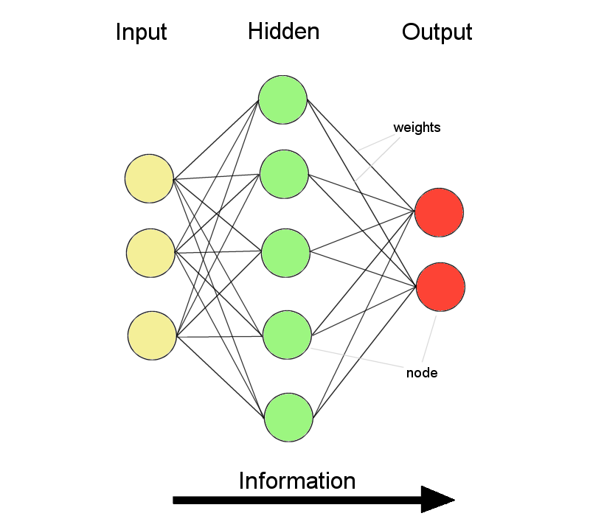
3.1 Typical architecture…
Multilayer net:

Slide 23
3.2 Setting the weights
Setting the weights = training
Two types of training:
Supervised
Unsupervised
Many of the task that ANN can be trained to perform fall into the areas of:
Mapping
Clustering
Constrained optimization

Slide 24
3.2 Setting the weights…
Supervised training
Training is accomplished by presenting a sequence of training vectors, or pattern, each with an assosiated target output vector
The weights are then adjusted according to a learning algorithm

Slide 25
3.2 Setting the weights…
Unsupervised training
Self-organizing neural nets group similar input vectors together without the use of training data to specify what a typical member of each group looks like
A sequence of input vectors is provided, but no target vectors are specified
The nets modifies the weights so that the most similar input vectors are assigned to the same output (cluster) unit

Slide 26
3.3 Common Activation function
Common activation function are:
Identity function : f(x) = x
Binary step function (with threshold θ)
f(x) = 1 if x ≥ θ
0 if x < θ
Binary sigmoid
Binary bipolar

Slide 27
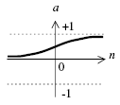
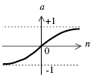
3.3 Common Activation function…
Sigmoid biner
Turunannya
Sigmoid bipolar
Turunannya
Sangat dekat dengan

Slide 28
Bias….
A bias can be included by adding a component Xo = 1 to input units (for single layer net).
1
b1
X1
w1
X2
w2
Y
w3
X3

Slide 29
pustaka
Fausett, L. 1994. Fundamentals of Neural Networks: Architecture, Algorithm, and Applications. Prentice Hall, Englewood Cliffs, NJ.
MAYZA, A. 2007. Materi Kuliah STIMULASI DAN PERKEMBANGAN OTAK PADA ANAK USIA DINI. Univ Negeri Jakarta.

